Slide 1
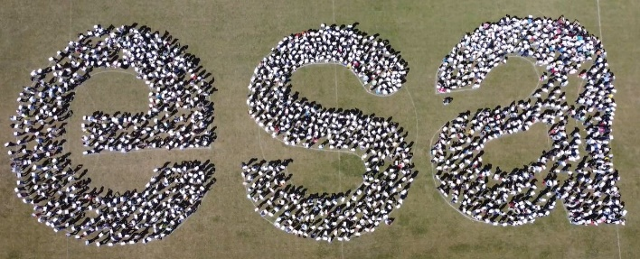

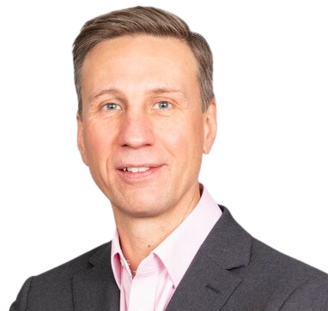
Space Passive Components Days
5th SPCD edition
ESA ESTEC 16/10/2024
Opening Speech & Introduction
Mr. Sylvain Bouchart
Head of the Electrical Department TEC-E

Slide 2
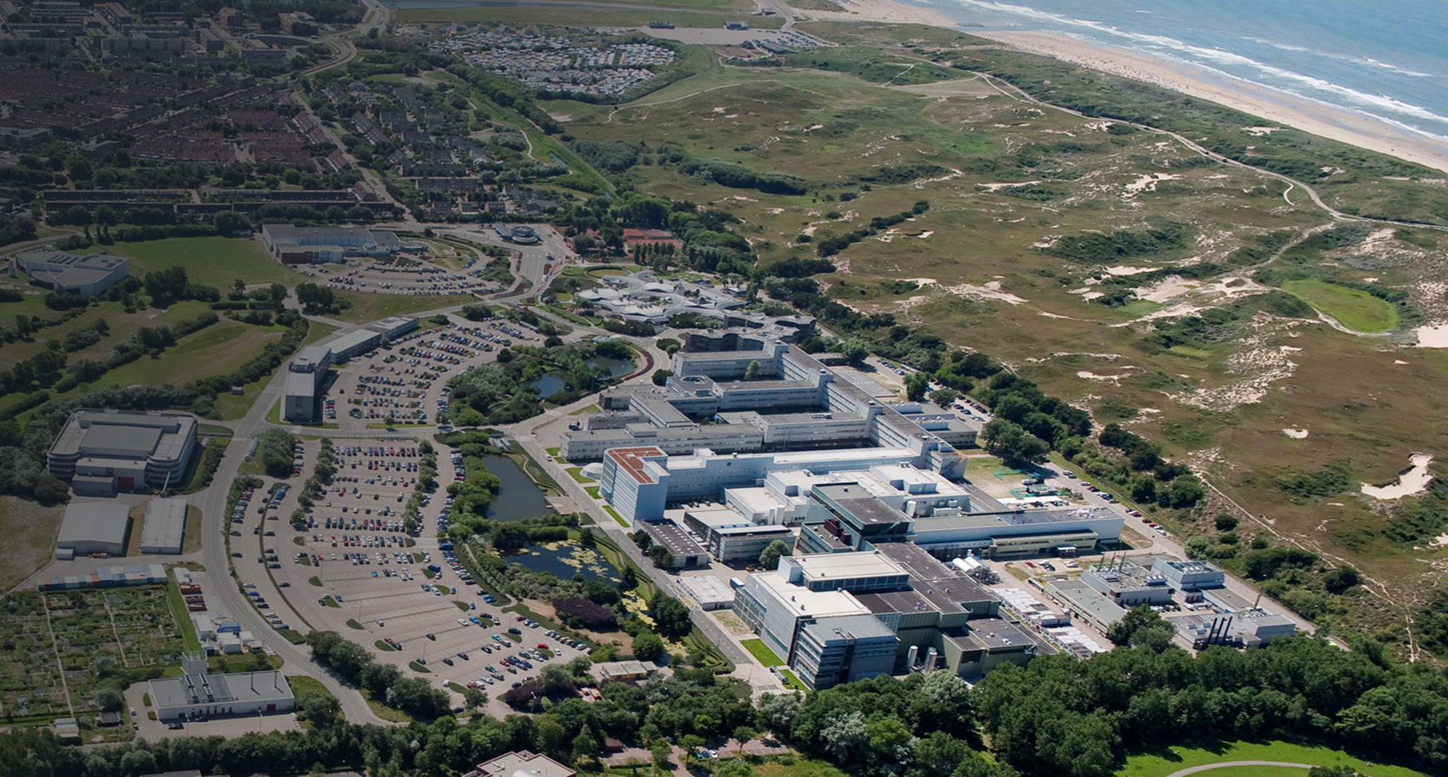

Welcome to ESTEC!
ESA’s largest site & technical heart
Engineers, technicians and scientists work hands-on with mission design, spacecraft and space technology
Most ESA projects are managed from ESTEC:
    Technology
    Human Spaceflight & Exploration
    Earth Observation
    Science missions
    Telecom missions & projects
    Satellite navigation
ESA UNCLASSIFIED – For Official Use
2

Slide 3













SPCD 2024
Jointly organized by
Co-sponsored by

Slide 4
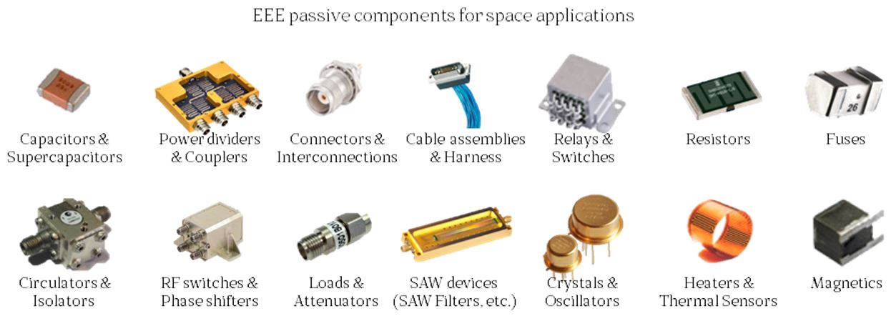
Aim of the SPCD Conference
The SPCD international Symposium is the premier technical conference dedicated to Passive components for space applications.

Slide 5





Aim of the SPCD Conference
Space Agencies
Promote discussions
Exchange technical expertise
Share information
Manufacturers
End-users
~240 Participants
24 Countries
40 Oral Presentations out of 52
19 TIC Presentations out of 22
6 Posters out of 8
1 Interactive Panel
2 Private Roadmap Presentations
31 Booths (and 7 in waiting list)

Slide 6
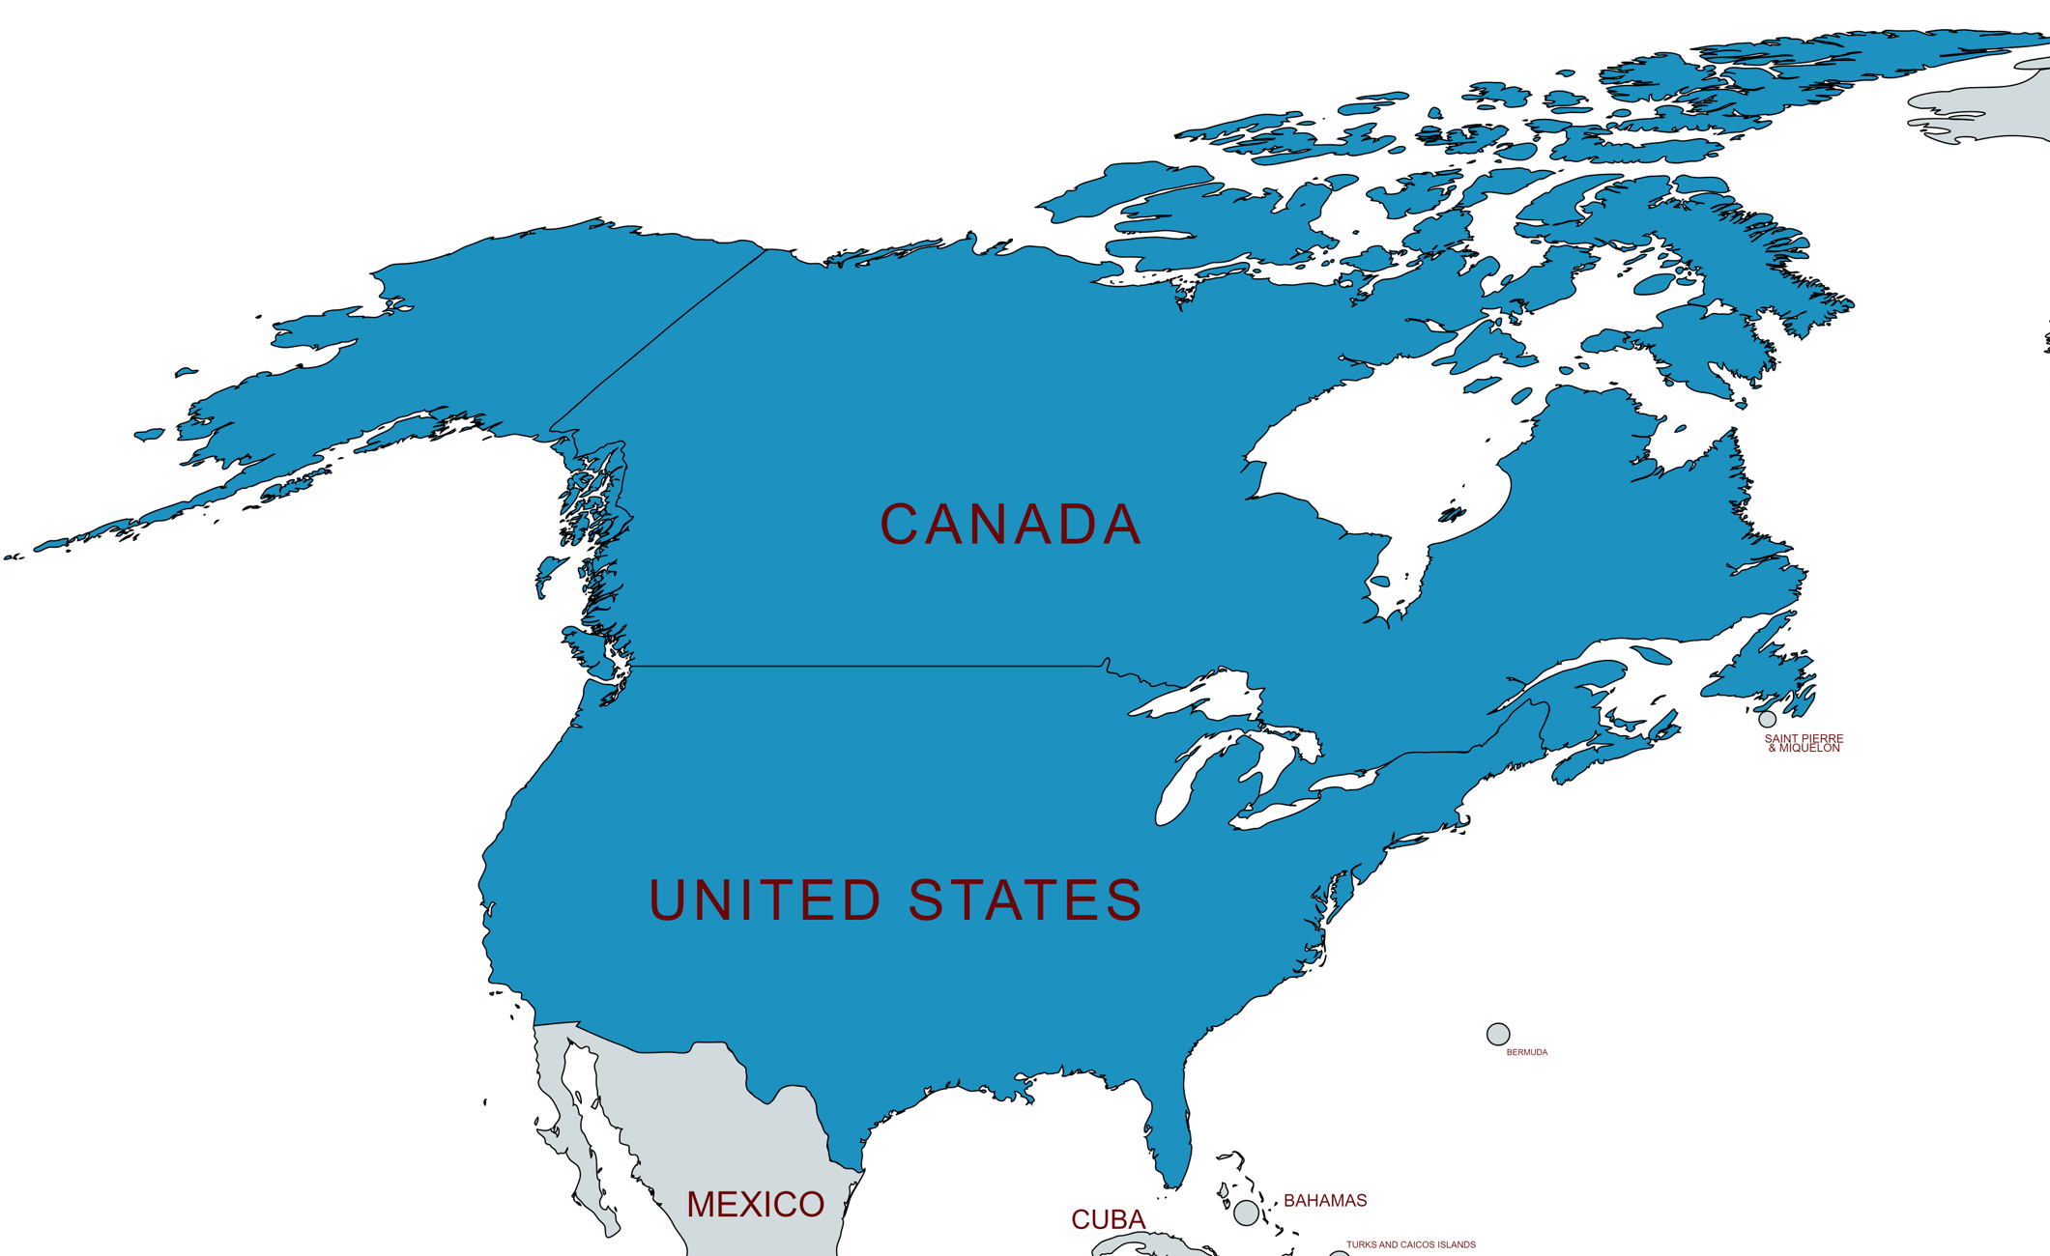
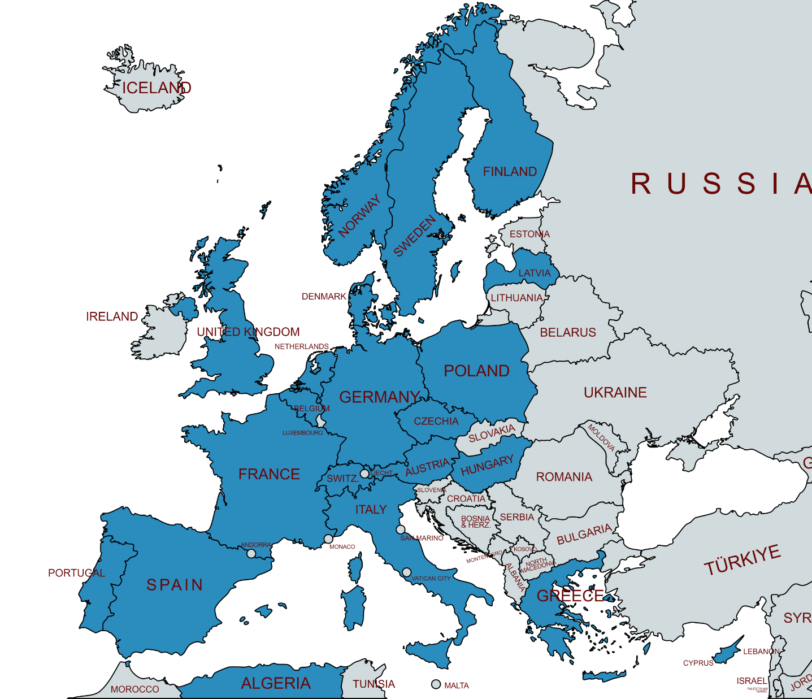
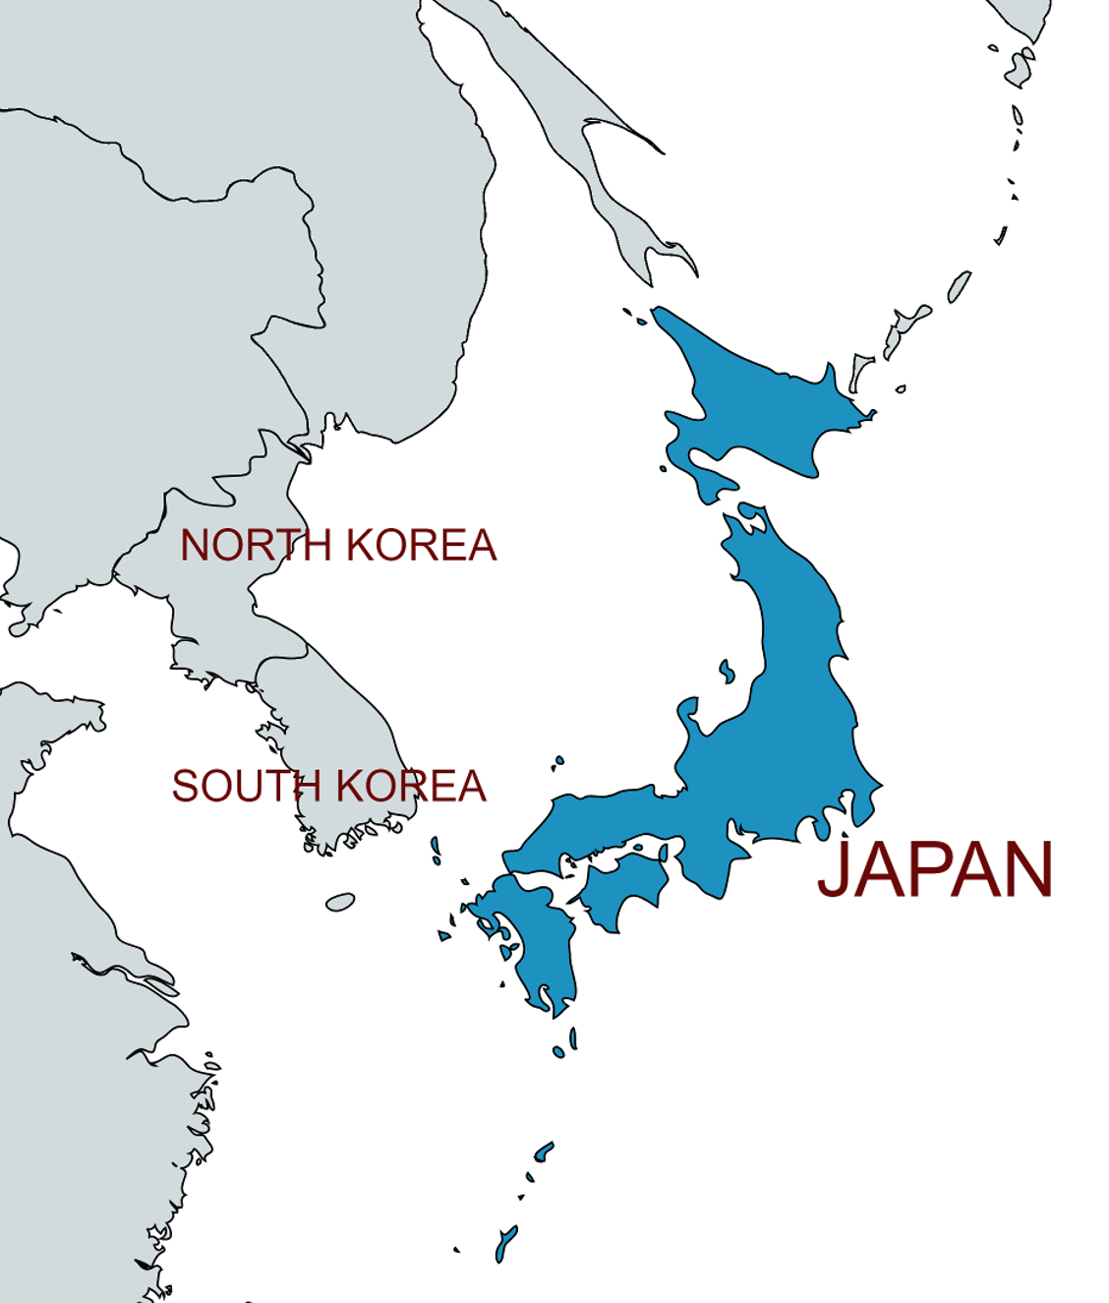
SPCD in numbers
SPCD | Participants | Countries
1st edition | 212 | 21
2nd edition | 221 | 19
3rd edition | 235 | 23
4th edition | 235 | 21
5th edition | 240 | 24

Slide 7
5th SPCD programme
Nine technical topics: 40 presentations
  Technology Roadmaps
  Commercial Off-The-Shelf
  Normative System & Standards
  New Developments
  Materials and Processes
  Application, Trends & Needs
  Test, Reliability & Evaluation for space
  Evaluation & Qualification
  Lessons Learned and In-flight Experiences
+ 19 x Technical Introduction of Components (TICs)
+ Interactive Panel session: Advancing Space Exploration: “The Role of AI Across the Entire EEE Life Cycle”
+ Dedicated Poster x6 session
+ Private Roadmap sessions
+ Industrial exhibition x 31

Slide 8
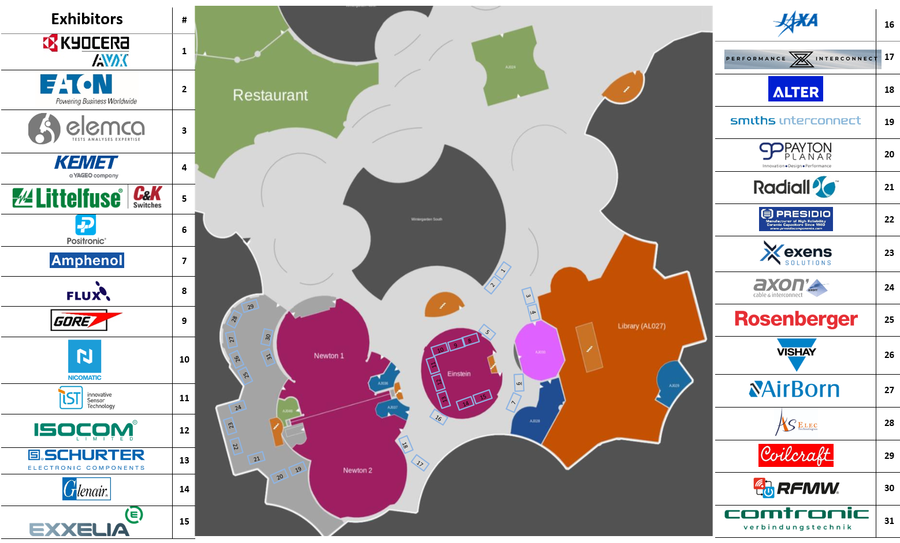
Exhibition Floor Plan

Slide 9
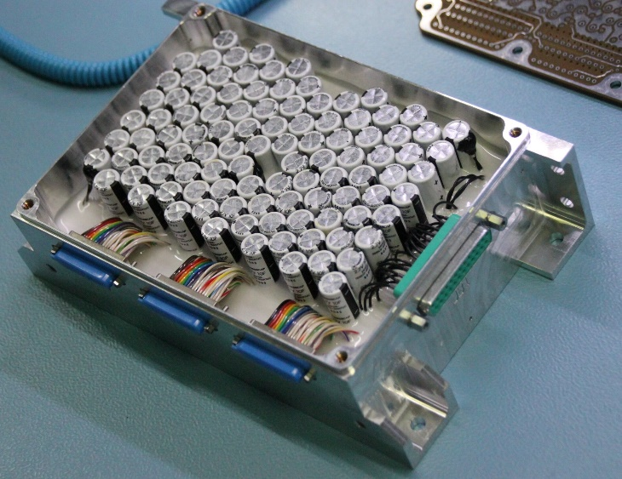
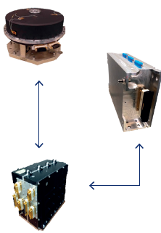

Success Story: From GSTP to Space
Building the Space Passive Component Supply Chain
  GSTP Activity (400 k€) “Generic Space Qualification of Supercapacitors”
  Contractors : AIRBUS D&S (FR) and Eggo Space (CZ)
  Outcome: Successfully designed, manufactured and Qualified a Bank Of Supercapacitors (BOSC).
  Strong Collaboration between TEC-EDC (Components) and TEC-EPB (Energy Storage)
ADS offers a high torque reaction wheels ideal for EO applications:
High Capability Actuator (HCA) for Small Satellites (200-500Kg)
This Smart Wheel relies on the BOSC to store energy during operative phases; this energy is then converted into kinetic energy of the wheel mechanism.
This HCA is already flying on an Earth Observation Satellite!

Slide 10

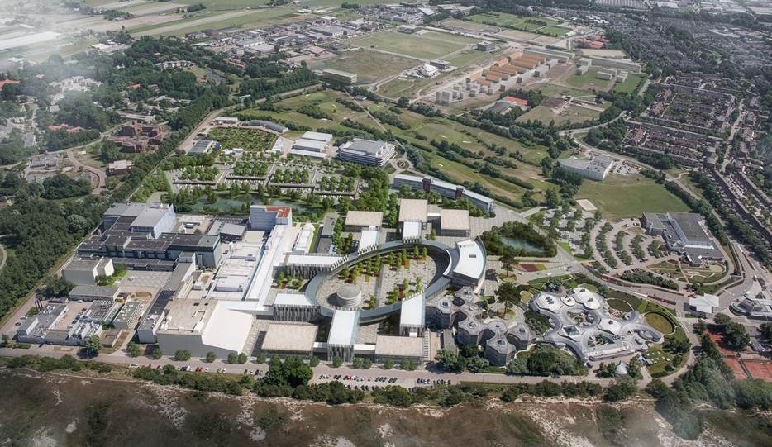
























10

Slide 11
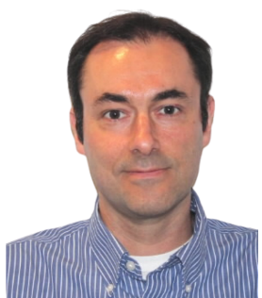
Space Passive Components Days
5th SPCD edition
ESA ESTEC 16/10/2024
Introduction
Dr. Ali Zadeh
Head of the Data Systems, Microelectronics and
Component Technology Division TEC-ED

Slide 12
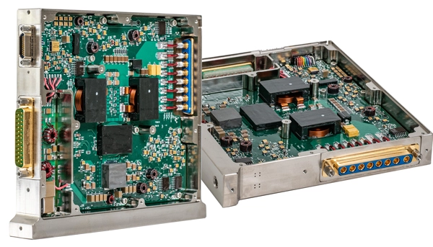
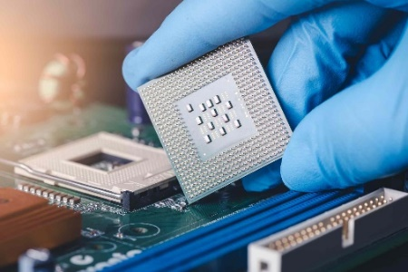
EEE Space Component Sovereignty for Europe
Time-to-market of qualified products
Strategic partnerships
Increase European competitive-ness
Sustainable products, no access restrictions
Strong European Supply Chain

Slide 13
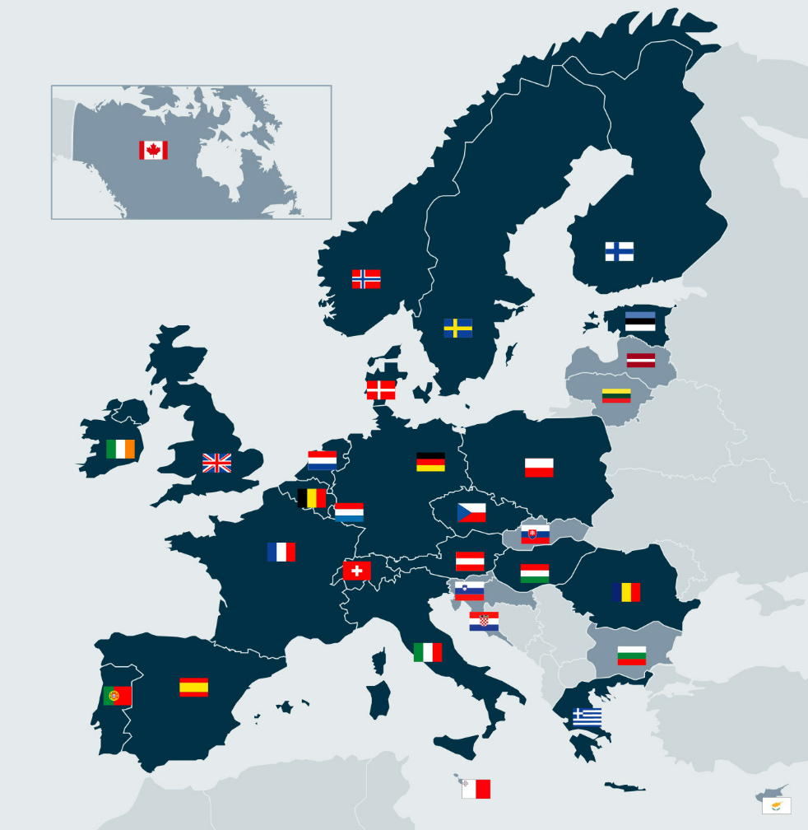

EEE Space Component Sovereignty for Europe
Bilateral with MSs and Industry
Detailed technology prioritization based on MS Inputs
EEE GSTP Component Compendium to February IPC
Work Plan and Procurement Plan to March IPC
First ITTs and KO in 2024
Aggressive schedule to achieve TTM
13 MSs subscribed to the initiative
~90MEuro of funding
6 Technology Lines
TEC-ED targeting UDSM, GaN power & RF, Packaging and Photonics

Slide 14

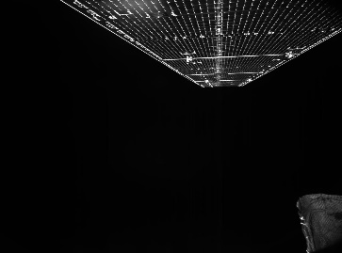
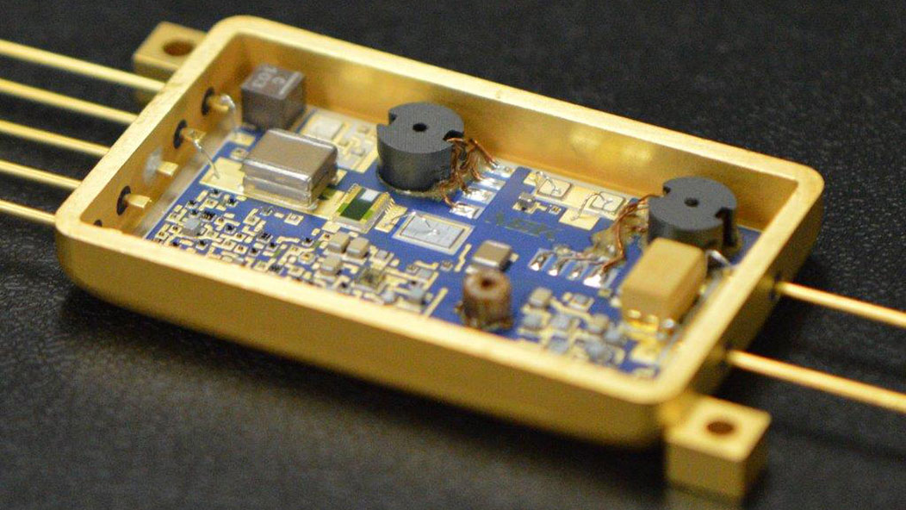
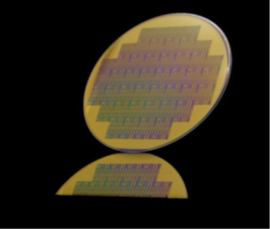
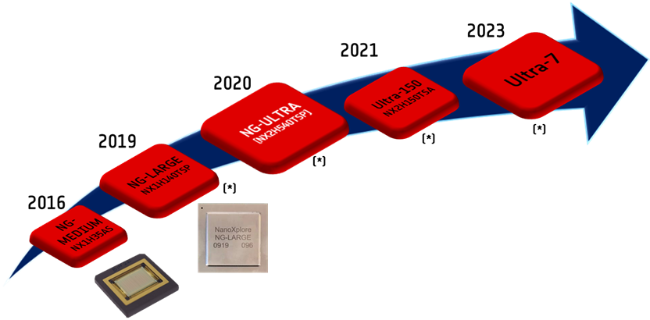
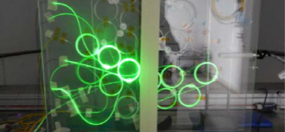
EEE Initiative towards CMIN25
Solar Cells
Wide Band Gap: GaN/SiC
Microwave/Power
Packaging and Hybrids, PCB, Electronic assembly
Test Facilities
(Ultra)Deep Sub Micron
Photonics
Passives & RF Passives

Slide 15
EEE Space Component Sovereignty for Europe
Creation of the GSTP Component “EEE Space Component Sovereignty for Europe” (GSTP EEE Component)
Implementation principles are based on approach used for GSTP Element 1 “Develop” (compendium, WorkPlan/Procurement Plan, Letter of Support, ITT, Contract)
Axis for Passive and RF passives
  High Current/Voltage/Energy/Power​​
  Miniaturisation/Integration​
  Cryogenic and High Temperatures​
  RF Passive applications​
Institutional support is needed to ensure European Sovereignty for space EEE components
European EEE Sovereignty Study:
Market analysis identifying critical component technologies and potential European supply chain for EEE including Passives. Evaluation of bidder’s proposals is ongoing.

Slide 16
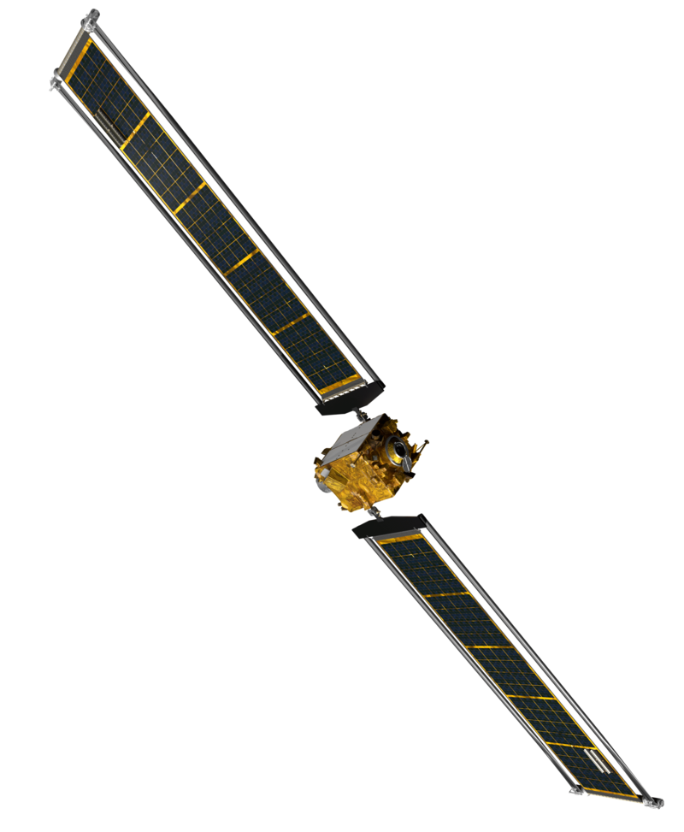
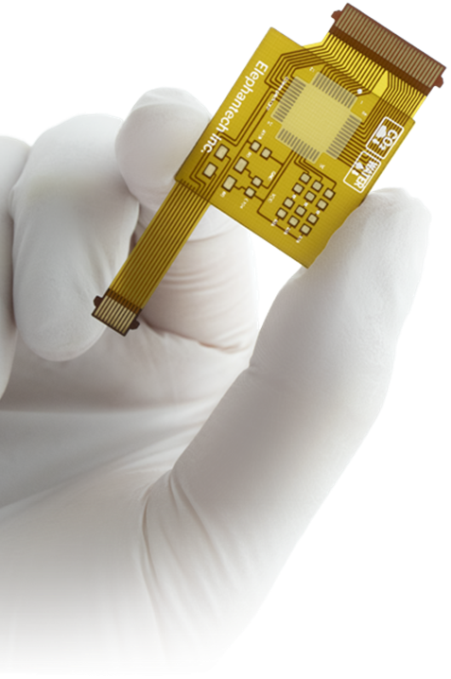
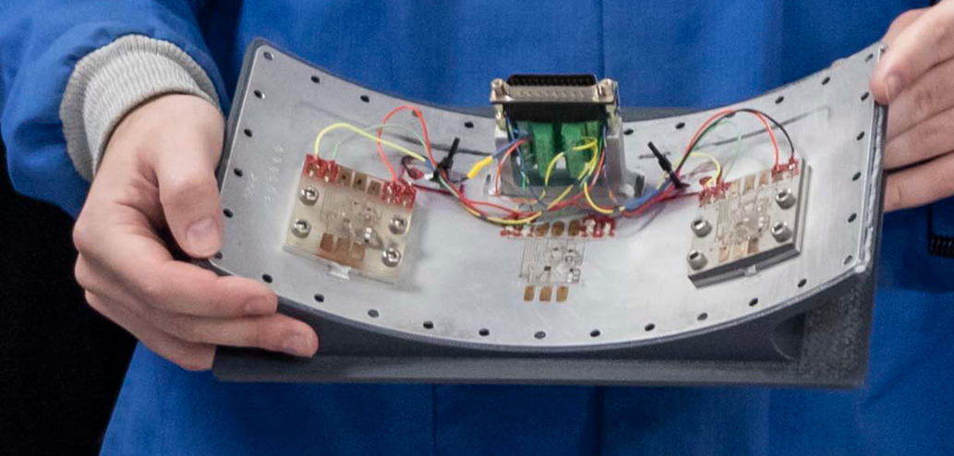
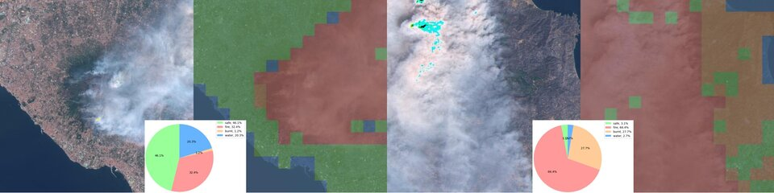

EEE : New Contributors to Space
Advanced Manufactured of Electronics (AME) in Space
Facilitate the industrialization of AME techniques and the development of a European, local, one-stop-shop supply chain for sustainable, fast, agile, and digital manufacturing of electronics and components.
“Advancing Space Exploration: The Role of Artificial Intelligence (AI) Across the Entire EEE Life Cycle"
Interactive Panel to discuss how AI is expected to transform the entire lifecycle of EEE components in the space industry.

Slide 17
Conclusions
EEE-component European Sovereignty is important for:
Facilitating European Competitiveness.
Ensuring the right technology, at the right maturity level is available at the right time unhindered by (export) restrictions.
Support the strategic space assets for the long-term benefit of Europe.
EEE contributors, such as Advanced Manufacturing of Electronics (AME) and Artificial Intelligence (AI), will play a crucial role in optimizing the development of EEE passive components.
Passive and RF passive EEE Components are key to this change.
The SPCD therefore represents a great venue to discuss new technologies and challenges ahead.

Slide 18
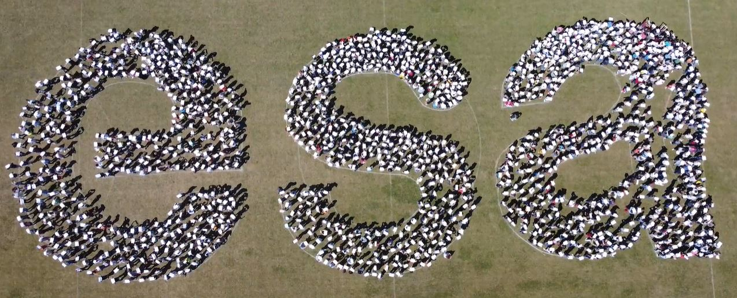
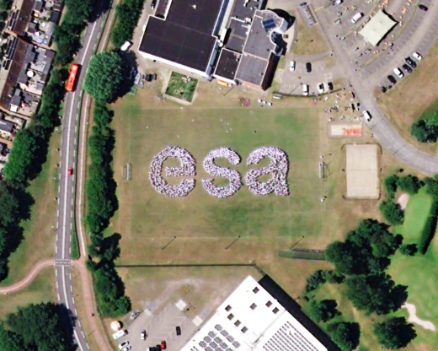
Space Passive Components Days
5th SPCD edition
Enjoy #SPCD

